Slide 1

Window title
Home
Healthy Food
Exercise Plan
Quiz
Hints n Tips
3:00PM
3/14/2011

Slide 2

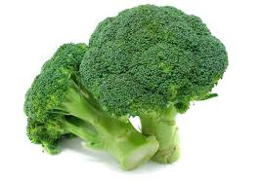

Window title
Home > Healthy Food
Exercise Plan
Home
Quiz
Hints n Tips
3:00PM
3/14/2011

Slide 3



Window title
Home > Exercise Plan
Healthy Eating
Home
Quiz
Hints n Tips
3:00PM
3/14/2011

Slide 4

Window title
Home > Quiz
Question 1 out of 10 : ………
Answer :
Healthy Eating
Exercise Plan
Home
Hints n Tips
3:00PM
3/14/2011

Slide 5



Window title
Home > Hints n Tips
Healthy Eating
Exercise Plan
Home
Quiz
3:00PM
3/14/2011
3:00PM
3/14/2011

